Slide 1
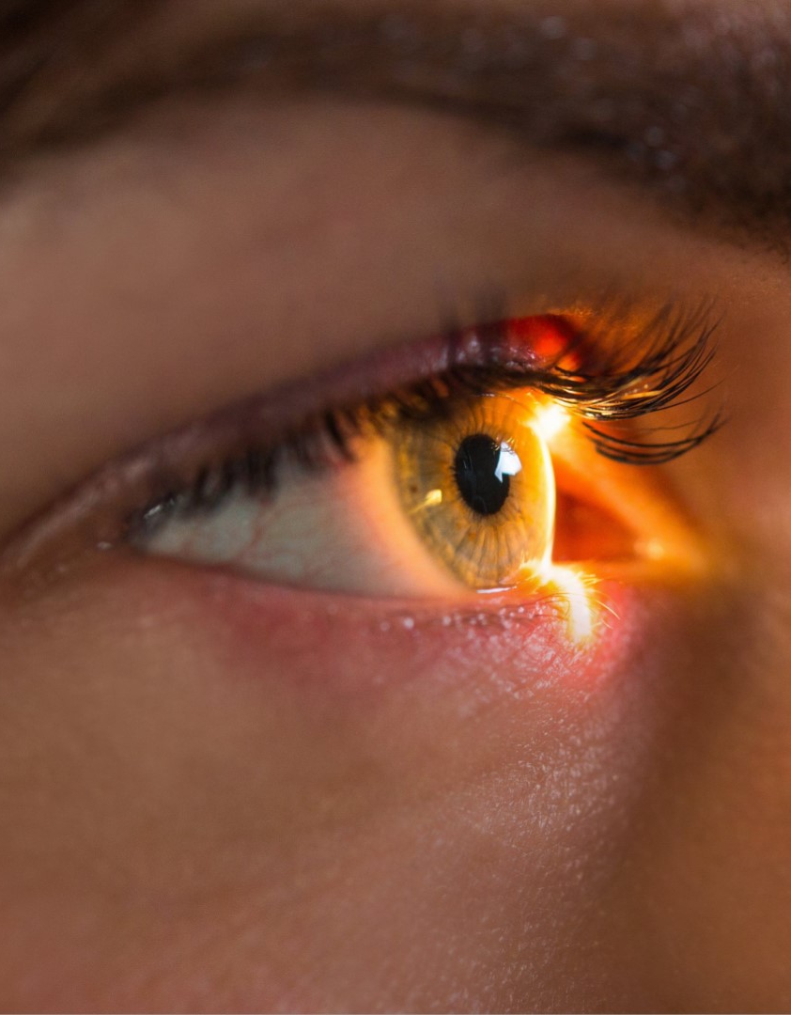
iBM Advanced data science capstone
PREDICTING OCCURRENCE OF GLAUCOMA
FROM RETINA FUNDUS IMAGES

Slide 2

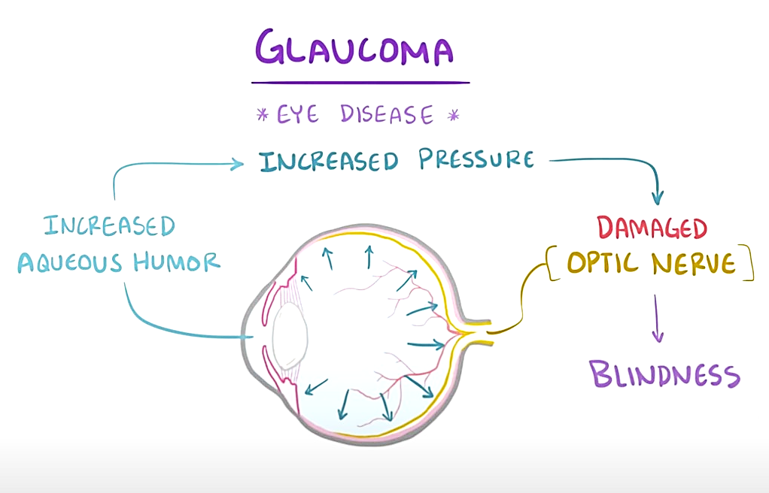
What is Glaucoma
WHAT IS GLAUCOMA? It is an eye disease in which the pressure of the fluid in the eye rises to a point that the optic nerve becomes damaged. The pressure that builds up occurs because too much fluid is formed or because the channel in the eye through which the fluid normally drains is blocked.

Slide 3
Glaucoma’s global Impact on vision Loss & Blindness
Statistics according to World Health Organization and the World Glaucoma Association:
People blind due to glaucoma: an estimated 4.5 million globally
Percent of all global blindness cause by glaucoma: slightly more than 12%
2nd most common cause of blindness worldwide
Percent of affected people that are not even aware of having glaucoma:
up to 50% in developed countries
may rise to 90% in undeveloped parts of the world
According to University of Melbourne:
Life expectancy is going up and vision needs to be preserved to maintain a good live quality
The size of the population with these eyes diseases has increased by a factor of about 1.5 due to increased life expectancy of population in the last 10 years.
Once retina is damaged, there is almost no chance to reverse the loss of vision unless some breakthroughs happen such as stem cell therapy.
Early detection is very important for eye diseases as early intervention can save vision or slowdown the progression in loss of vision.
It is nearly impossible to perform early detection on a large population (more than a billion) by clinicians.
We need automated tools for screening, prediction and tracking the progression of eye diseases for whole population.

Slide 4
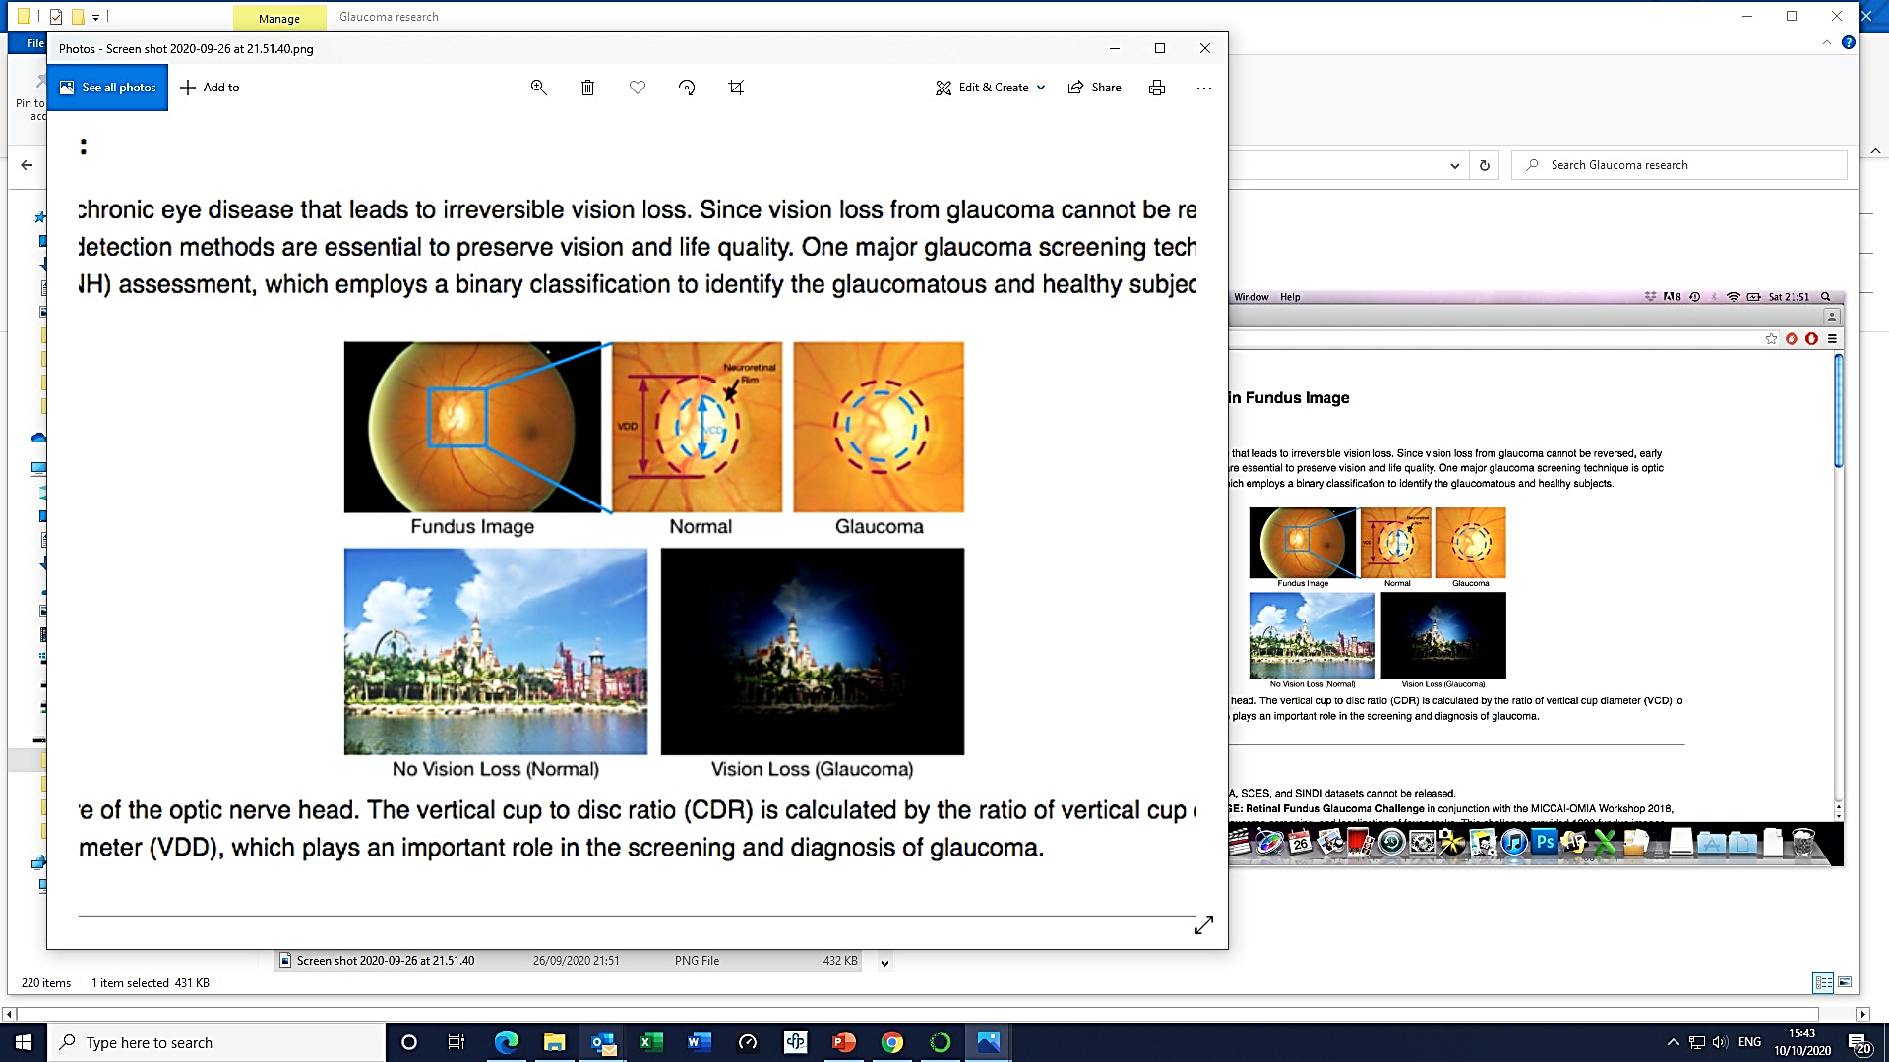
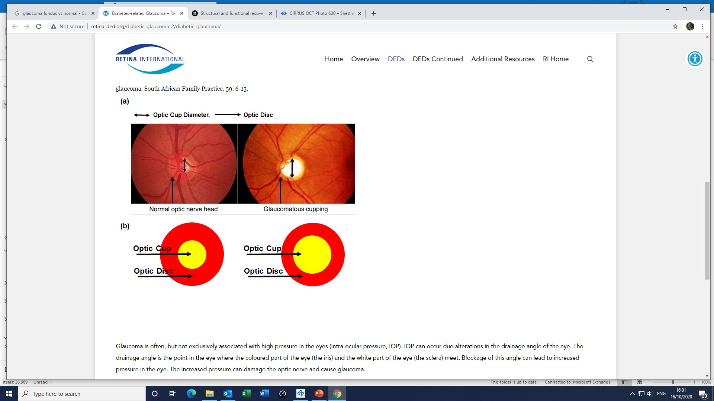
Glaucoma Screening in fundus images
Glaucoma is the second leading cause of blindness in the world behind cataracts, but, unlike cataracts, the vision loss associated with glaucoma is largely irreversible. One major glaucoma screening technique is optic nerve head (ONH) assessment.

Slide 5
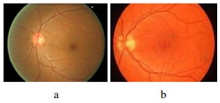
STAKEHOLDER PRESENTATION
USE CASE AND DATASET
Use case:
- Classifying retinal fundus images as glaucoma or nonglaucoma (normal)
- Training a model to classify retinal fundus images from a dataset of labelled images
Dataset:
- ORIGA-light : An Online Retinal Fundus Image Database for Glaucoma Analysis and Research
This Database consists of 650 images (including 168 glaucomatous images and 482 randomly selected nonglaucoma images) from SiMES study. Each image is segmented and annotated by trained professionals from Singapore Eye Research Institute.
- research done by 8 authors:
Zhuo Zhang, Feng Shou Yin, Jiang Liu, Wing Kee Wong, Ngan Meng Tan, Beng Hai Lee, Jun Cheng, Tien Yin Wong
- Images downloaded from Kaggle open data source
https://www.kaggle.com/sshikamaru/glaucoma-detection
CSV file provides file names, CDR (cut to disk ratio) and classification of Glaucoma negative(a) or positive(b)
If CDR ≥ 0.65, the image is Glaucoma positive.
If CDR <0.65, the image is Glaucoma negative.

Slide 6
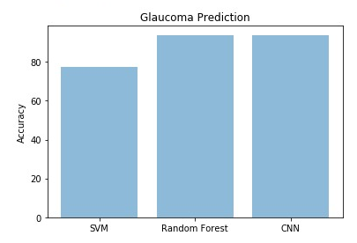
STAKEHOLDER PRESENTATION
SOLUTION AND RESULTS
Shuffled the dataset (650 jpeg images in total, 196 Mb) and split into
-Training (80% of images, 520 images of which 134 Glaucoma positive and 386 Glaucoma negative)
- Validation (20% of image, 130 images of which 34 Glaucoma positive and 96 Glaucoma negative).
Best results with deep learning model - Convolutional Neural Network (CNN) in Keras, TensorFlow.
- Batch size: 64
- Number of Epochs: 20
- Architecture: Convolution layers followed by dense layers
- Optimizer: Adam
- Test loss: sparse categorical crossentropy 2.0893890133e-05
- Accuracy on test data: 93.83%
We tried 2 machine learning models:
- SVM (support vector machine), accuracy on test data: 71.53%
- Random Forest, accuracy on test data: 93.50%

Slide 7
PEER PRESENTATION
INITIAL DATA EXPLORATION
DATASET:
- 650 images (jpeg) saved into labelled input folder Fundus_Train_Val_Data
- uneven distribution of classes (26% glaucomatus (168 images) and 74% nonglaucomatus (482 image)).
- Image size from 192KB – 437KB
- Image dimensions 3072 x 2048 pixels
- Resolution 96 dpi
- Bit depth 24
- RGB color mode
DATA CLEANSING AND FEATURES CREATION
- Global centering, calculate global mean, global centering of pixels, pixel normalization
- Resize images to 512 x 512 pixels
- Split RGB image into 3 channels (Red, Green, Blue)
- Image segmentation using SciPy Signal Gaussian window filter
- Plot preprocessed Green channel and smoothed histogram Green channel
- Plot preprocessed Red channel and smoothed histogram Red channel
- Numpy.convolve to return linear convolution of two one-dimensional sequences.
- Numpy.ravel to change a 2-dimensional array into contiguous flattened array.
- Convert images to grey scale
- Morphological segmentation for defining optic disc from Green channel and optic cup from Red channel

Slide 8
PEER PRESENTATION
ARCHITECTURAL CHOICES
Anaconda Navigator, Jupyter notebook 5.7.8, Python 3
Anaconda Cloud
Image loading / transformation:
OS module for interacting with operating system
TKinter for standard Graphical User Interface (GUI) package (filedialog)
Scikit-image for importing data and Scikit-image.feature ‘greycomatrix’ and ‘greycoprops’ for extracting features from images
SciPy signal for Gaussian window filter
OpenCV (cv2.imread) for reading images and (cv2.resize) for resizing images and (cv2.split) for splitting RGB into 3 channels (Red, Green, Blue) and for Morphological segmentation.
Traditional Machine learning algorithm: Scikit-learn for SVM and Random Forest
Deep learning algorithm: tensorflow with tensorflow.keras for CNN Classification

Slide 9
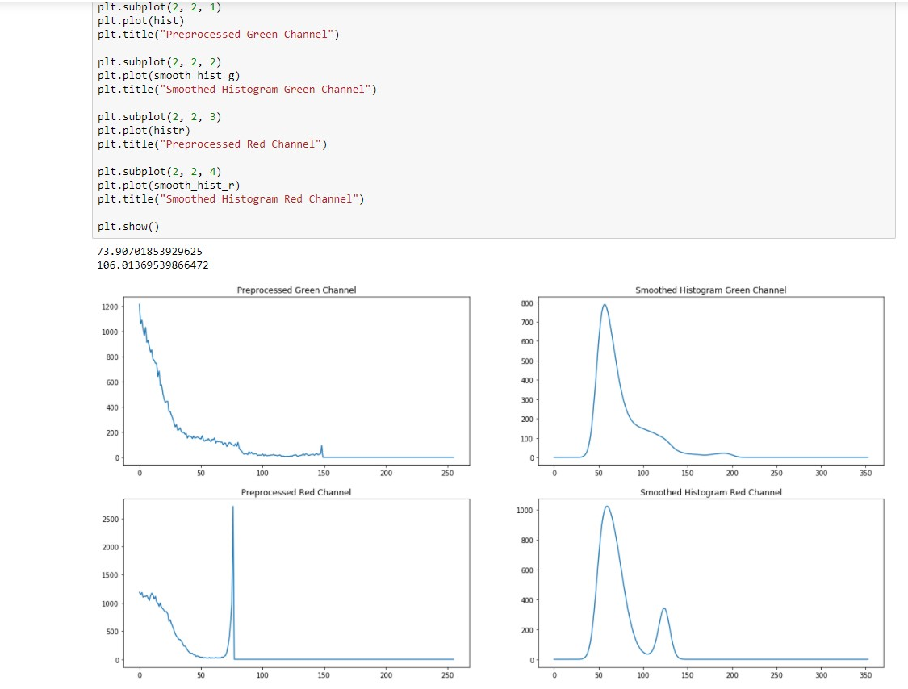
PEER PRESENTATION
SEGMENTATION (GAUSSIAN FILTER)

Slide 10
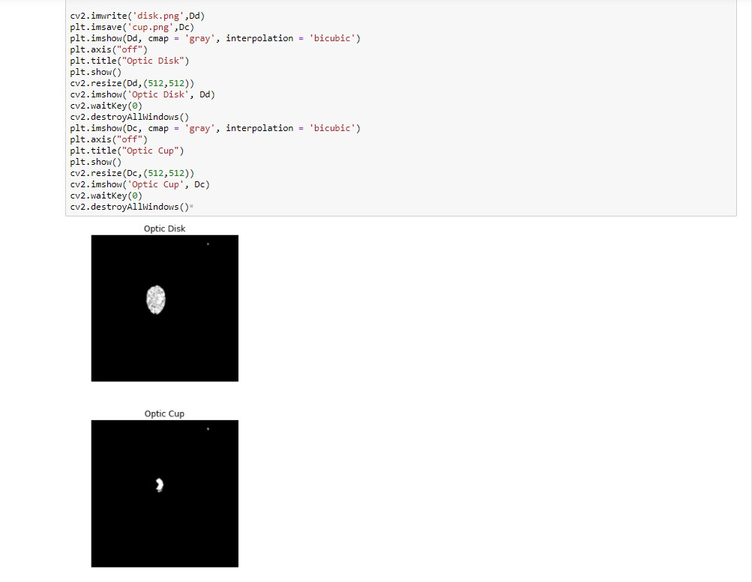
PEER PRESENTATION
MORPHOLOGICAL SEGMENTATION

Slide 11
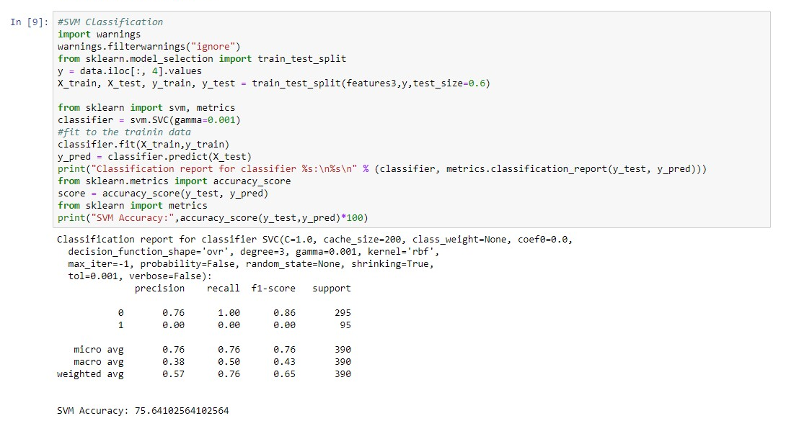
PEER PRESENTATION
MODEL ALGORITHM 1: SUPPORT VECTOR MACHINE (SVM)

Slide 12
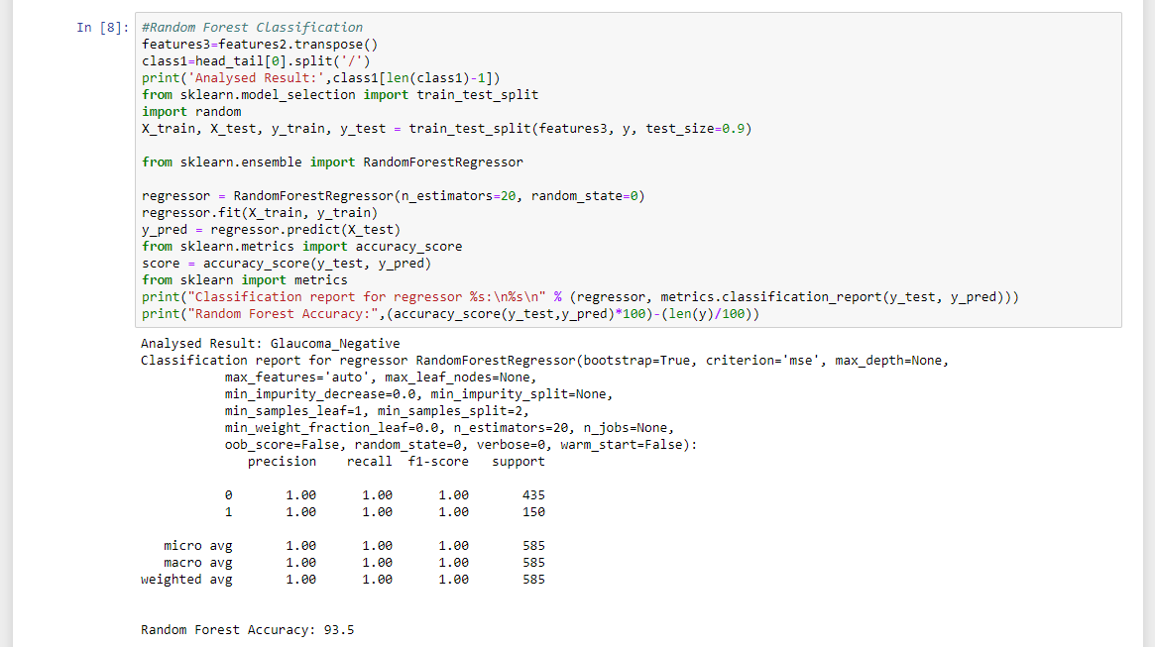
PEER PRESENTATION
MODEL ALGORITHM 2: RANDOM FOREST

Slide 13
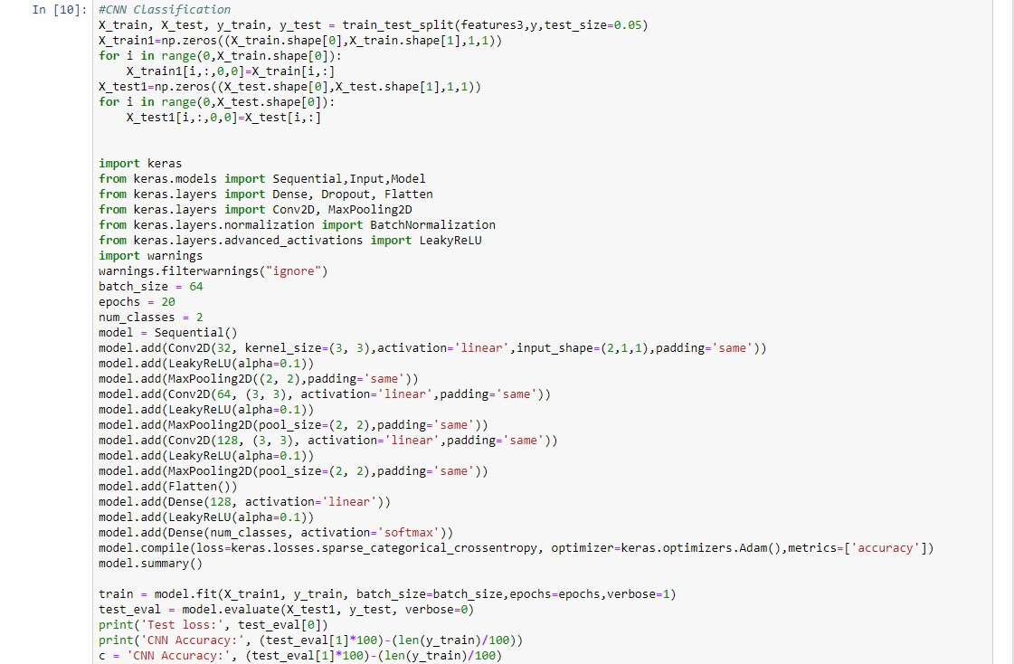
PEER PRESENTATION
MODEL ALGORITHM 3: CNN Classification
Test loss: 2.5051628102973513e-05
CNN Accuracy: 93.83

Slide 14
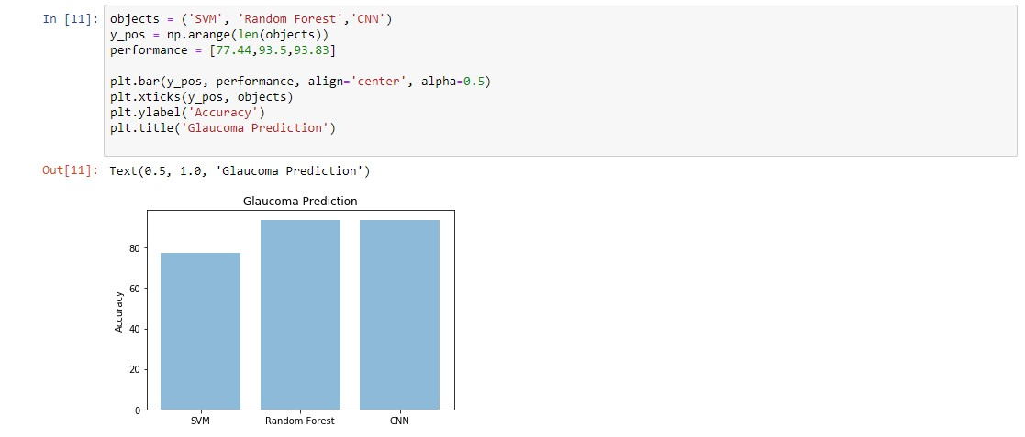
PEER PRESENTATION
MODEL EVALUATION
Best results with deep learning model - Convolutional Neural Network (CNN) in Keras, TensorFlow. Accuracy on test data: 93.83%
SVM (support vector machine), accuracy on test data: 71.53%
Random Forest, accuracy on test data: 93.50%

Slide 15
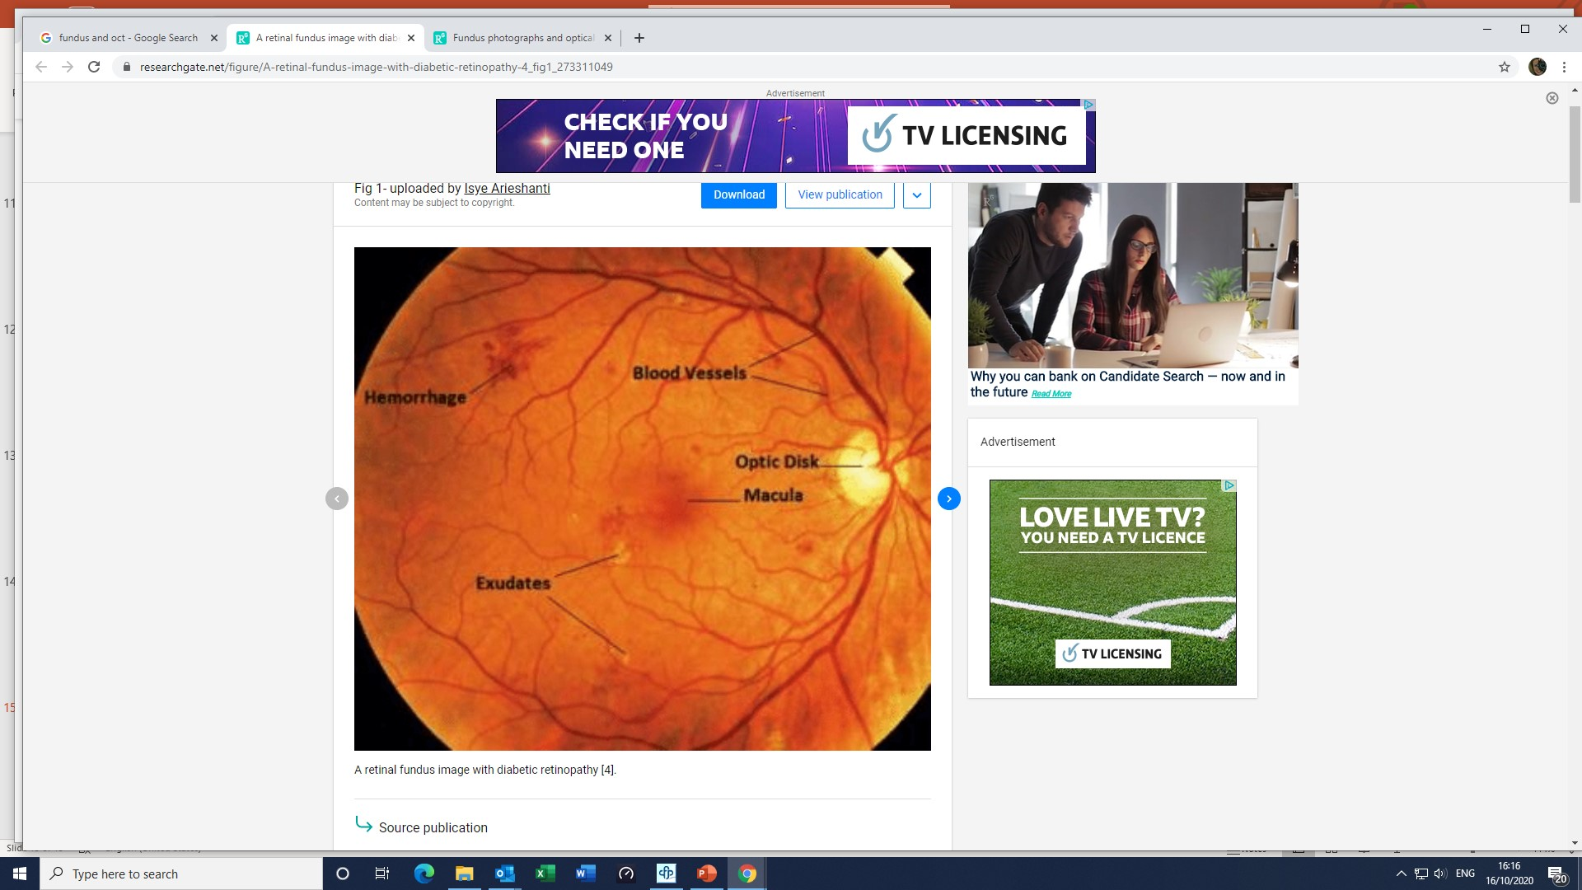
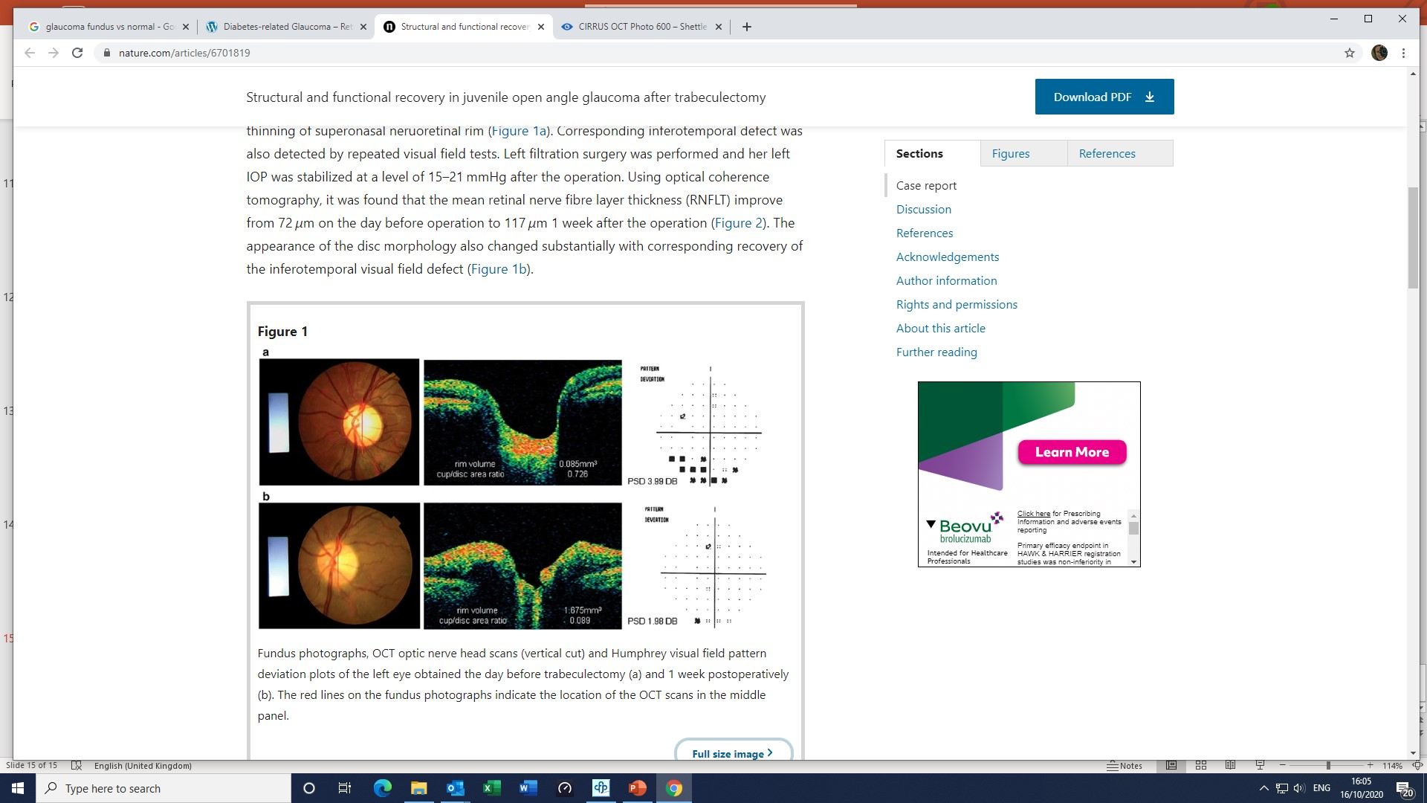
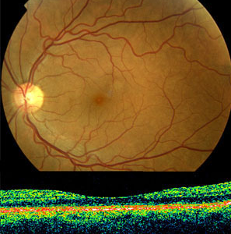
SUMMARY
Descent model with a reasonable computing need for training (both Random Forest and CNN)
Very limited overfit based on our test data
Further steps:
Try to access a larger fundus image dataset and train models on more images to get a better accuracy.
Build deeper network with more adaptive learning (Adam first then SGD + momentum for instance)
Try different deep learning models (Resnet50, U-net)
Try extracting more features from the image (blood vessels, fovea, pigmentation, hemorrhage)
Analyze Optical Coherence Tomography (OCT) image. OCT is a non-invasive imaging technique that allows eye care professionals
to measure the thickness and health of the retina’s multiple layers and helps diagnose glaucoma’s stage and type.
Glaucoma fundus and OCT
Normal fundus and OCT

